Slide 1
Dart Basics
Prepared by Amira Nasser & Fares Ahmed
amira20nasser@gmail.com
LinkedIn
Amira Nasser | Facebook

Slide 2
Rules
We deal with Mohsen
Good things give you Mohsens
Participate in session
Submit task
Absence of two meetings without a real excuse
(alert + affect on your Mohsens)
Notes:
According season
- UI - test UI -

Slide 3
Agenda
01
02
03
04
Data Types
Null safety
Functions & Parameters
Control Flow
05
OOP

Slide 4
01
Data Types

Slide 5
In general, what’s the difference primitive & reference Data Types
Notes:
In Dart, all types are reference types, meaning that all variables refer to an object (an instance of a class)

Slide 6
Primitive
primitive data type is a data type that is built into a programming language & have limited range or precision
Ex: int range( -2147483648 to 2147483647 )

Slide 7
Reference
Reference types store the address of the object they refer to, not the object itself
Notes:
Address store in stack (part of memory) and value in heap (another part of memory)

Slide 8
Note
In Dart, all types are reference types, meaning that all variables refer to an object (an instance of a class)
Notes:
types are more closely supported by the runtime system and have special rules or restrictions. These types are int, double, String, and bool, and they are sometimes called fundamental types or built-in types . These types are implemented to be immutable (unchanging) which means they behave as if they are value types
int x = 0;
int y = x;
x = 4;
print(y); //print 0 when you assign y = x, you are not copying the reference to the object that x refers to, but the value 0 itself.

Slide 9
Data types
num
String
bool
List
Map
Set
int , double

Slide 10
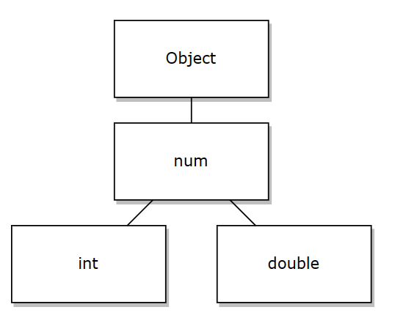
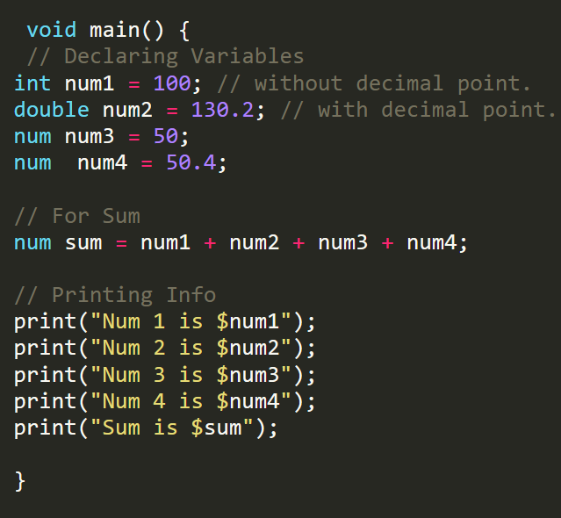
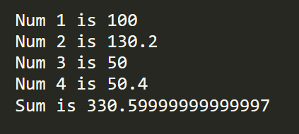
Output

Slide 11
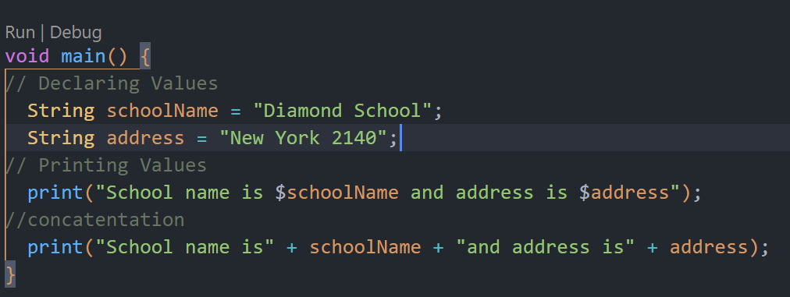
String
Notes:
void main() {
// Declaring Values
String schoolName = "Diamond School";
String address = "New York 2140";
// Printing Values
print("School name is $schoolName and address is $address");
//concatentation
print("School name is" + schoolName + "and address is" + address);
}

Slide 12
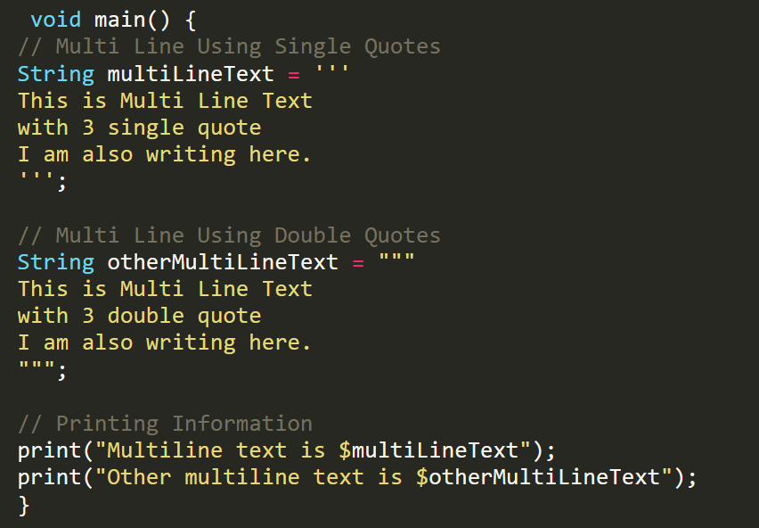
Multiple Line

Slide 13
Some String Methods
toLowerCase()
toUpperCase()
trim(): Returns the string without any leading and trailing whitespace.
compareTo()
split()
substring()

Slide 14
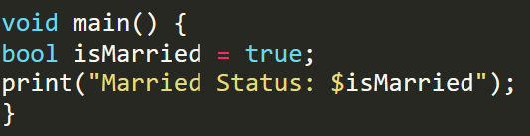
Boolean

Slide 15
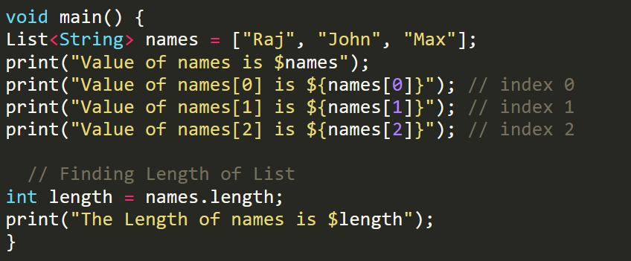
List
Notes:
void main() {
List<String> names = ["Raj", "John", "Max"];
print("Value of names is $names");
print("Value of names[0] is ${names[0]}"); // index 0
print("Value of names[1] is ${names[1]}"); // index 1
print("Value of names[2] is ${names[2]}"); // index 2
// Finding Length of List
int length = names.length;
print("The Length of names is $length");
}

Slide 16
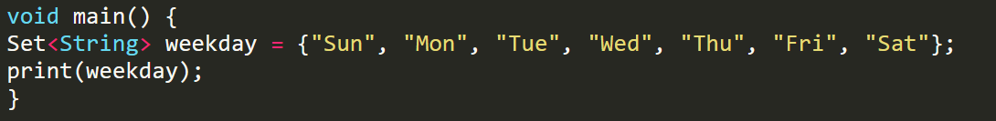
Set
Notes:
void main() {
Set<String> weekday = {"Sun", "Mon", "Tue", "Wed", "Thu", "Fri", "Sat"};
print(weekday);
}

Slide 17
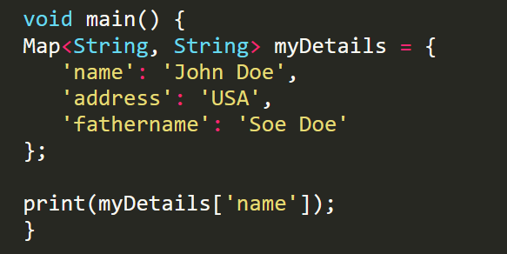
Map
Notes:
void main() {
Map<String, String> myDetails = {
'name': 'John Doe',
'address': 'USA',
'fathername': 'Soe Doe'
};
print(myDetails['name']);
}

Slide 18
var & dynamic
var
Type inference: automatically determining the type of a variable based on the value assigned to it.
dynamic
Dynamic typing : allowing a variable to hold any type of value at run time
Be careful when use dynamic
Notes:
void main() {
dynamic x = ‘amira';
x = 123;
print(x);
var a = ‘amira';
a = 123;
print(a);
}

Slide 19
Compile time error?
var member1;
member1="amira";
member1=10;
var member2="Menna";
member2=20;
ERROR!! Why?
Not ERROR

Slide 20
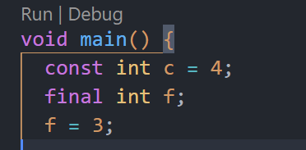
const & final
const
Value fixed in compile time
(must know this value once declare it)
final
Value fixed in runtime time
(can give the value after declare it)
Notes:
void main() {
const int c = 4;
final int f;
f = 3;
print(f);
print(c);
}

Slide 21
02
Null Safety

Slide 22
Meaning of null
a variable does not currently hold any meaningful value or does not refer to any object.

Slide 23
Null Safety
prevent null reference errors and makes code more reliable by ensuring that variables are non-nullable unless explicitly marked as nullable.
Notes:
This is a non-nullable field, must be initialized.
Note:
“any variable must be assign to value or make it nullable by ?”

Slide 24
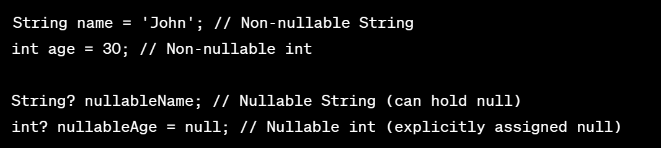
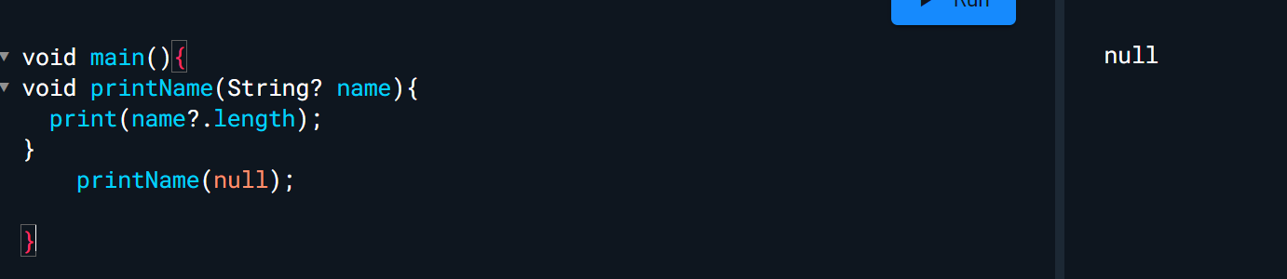
? Nullable Operator
?. Conditional Property access
Notes:
String name = 'John'; // Non-nullable String
int age = 30; // Non-nullable int
String? nullableName; // Nullable String (can hold null)
int? nullableAge = null; // Nullable int (explicitly assigned null)
----------------------------------
void printName(String? Name){
Print(name?.length);
}
printName(null);

Slide 25
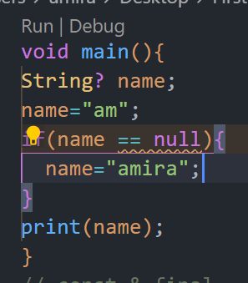
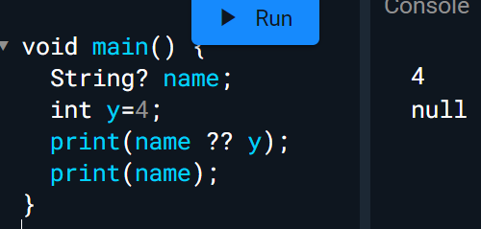
?? null-aware operator
expression1 ?? Expression2
If expression1 is null , do expression 2

Slide 26
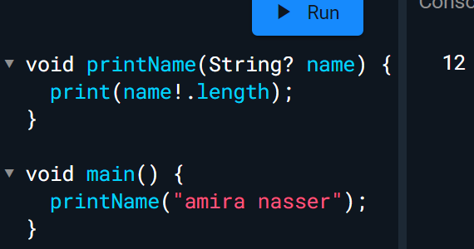
! Assertion Operator
You are asserting that it is non-null. or You promise to the compiler that it’s non-null.

Slide 27
03
Functions & Parameters
amira20nasser@gmail.com
LinkedIn
Amira Nasser | Facebook

Slide 28
Function
int lengthString (String name){
return name.length;
}
lengthString(String name)=> name.length;
isSuccess(int grade)=> grade > 50;
bool isSuccess(int grade){
return grade > 50;
}
void printName(String name ){
print("Your name is $name");
}
printName(String name)=>print("Your name is $name");

Slide 29
Types of Parameters
Required, positional parameters.
void greet(String name, int age) {
print("Hello ,$name Your age is $age");
}
Optional (nullable), positional parameters
void greet([String? name, int? age]) {
print("Hello ,$name Your age is $age");
}
Notes:
Required, positional parameters.
you must provide arguments for each required parameter in the same order as they are defined in the function signature. Required, positional parameters.
Optional(nullable), positional parameters
you must provide arguments for each required parameter in the same order. It’s not mandatory to pass the arguments between [].

Slide 30
Types of Parameters
Optional, named parameters
void greet({String? name, int? age}) {
print("Hello ,$name Your age is $age");
}
Named, optional & required parameters.
void greet({required String? name, required int? age}){
print("Hello ,$name Your age is $age");
}

Slide 31
04
Control Flow

Slide 32
If Condition
if(x==3){
print("x = 3");
}else{
print("not equal 3");
}
Shorthand Notation
(x==3) ? print("x = 3") : print("not equal 3");

Slide 33
Control Flow
for loops
while and do while loops
break and continue

Slide 34
Break & Continue
for (int i = 0; i < 5; i++) {
if (i == 3) {
break;
}
print("Hello");
}
for (int i = 0; i < 5; i++) {
if (i == 3) {
continue;
}
print("Hello");
}

Slide 35
05
OOP

Slide 36
Introduction to Object-Oriented Programming (OOP)
Object-Oriented Programming (OOP) is a programming paradigm that organizes data and behavior into objects, allowing for easier code maintenance and reusability. It emphasizes concepts such as encapsulation, inheritance, and polymorphism.

Slide 37
OOP Principles
1
2
3
4
Encapsulation
Inheritance
Share characteristics and behaviors between classes, enabling code reuse and creating hierarchical relationships.
Encapsulate related data and behaviors into objects, allowing for better organization and easier maintenance of code.
Abstraction
Polymorphism
Abstract complex systems into simplified models, hiding unnecessary details and providing a higher level of understanding.
Create flexible code that can take on different forms, allowing for variation in behavior based on object types.

Slide 38
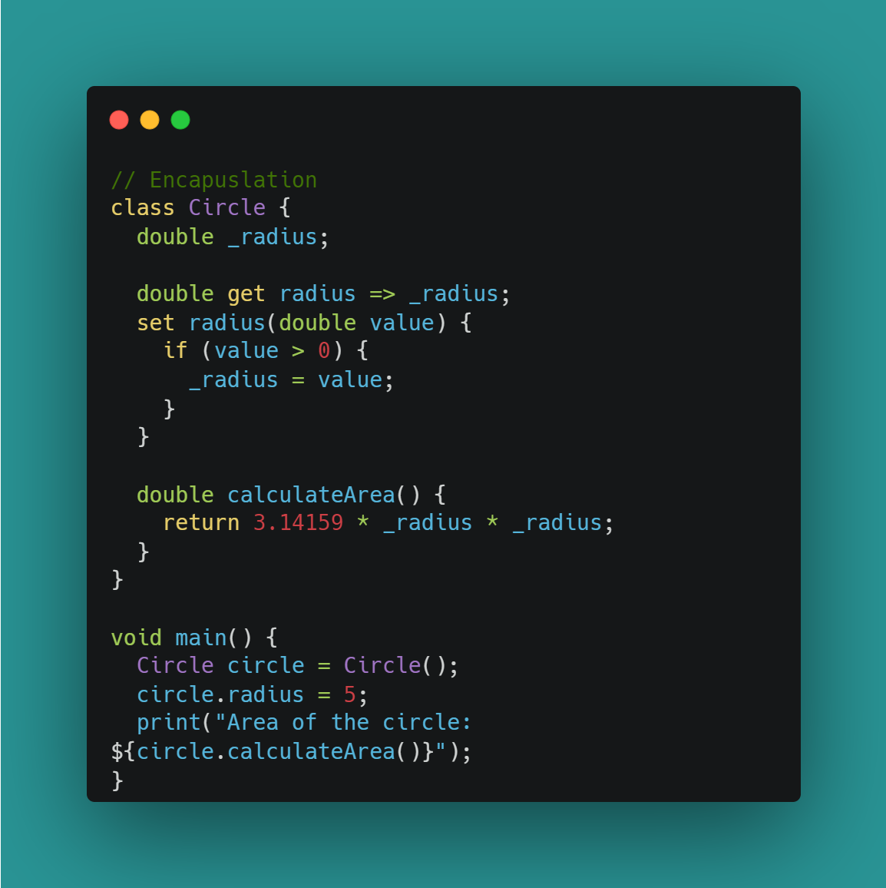
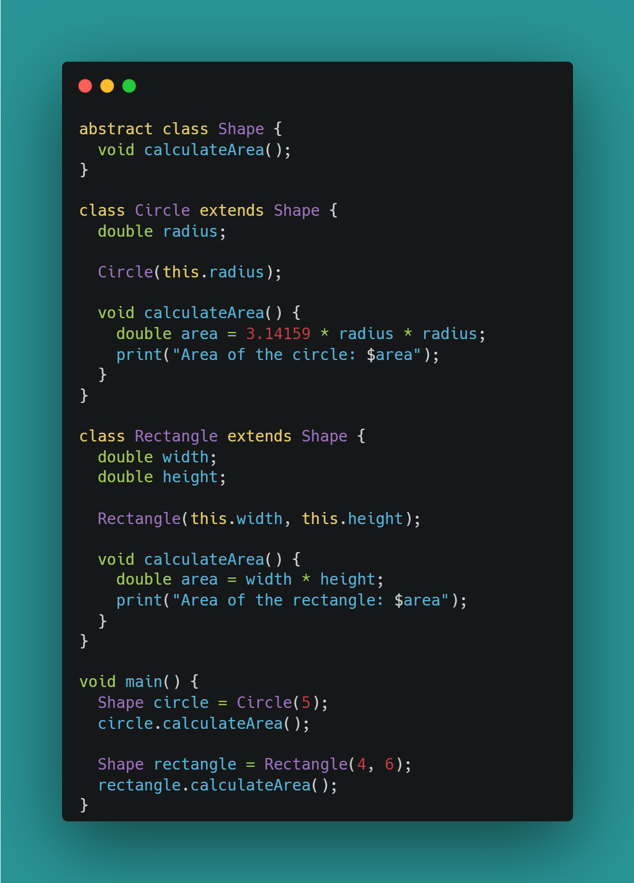
OOP Principles
1
Encapsulation
Abstract
2

Slide 39
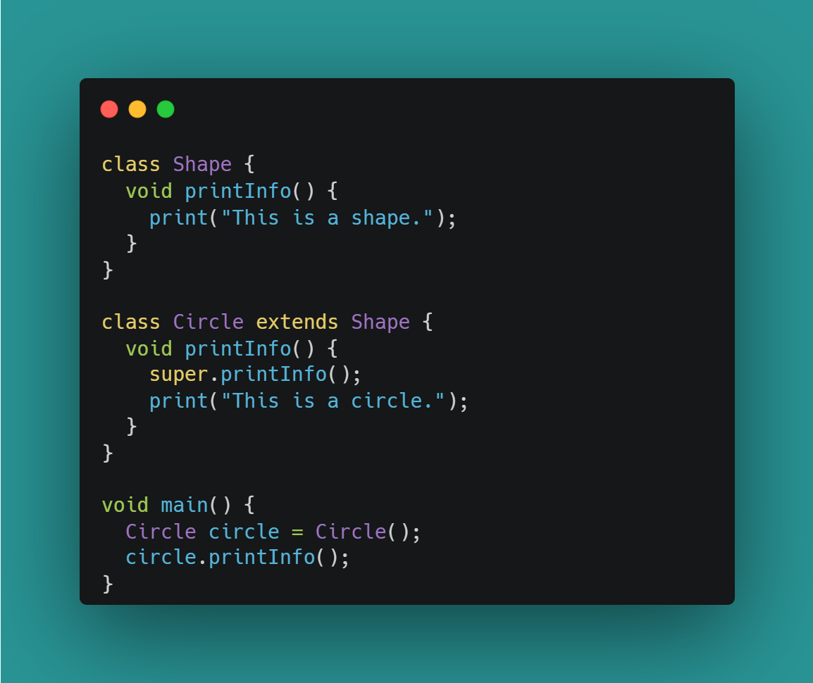
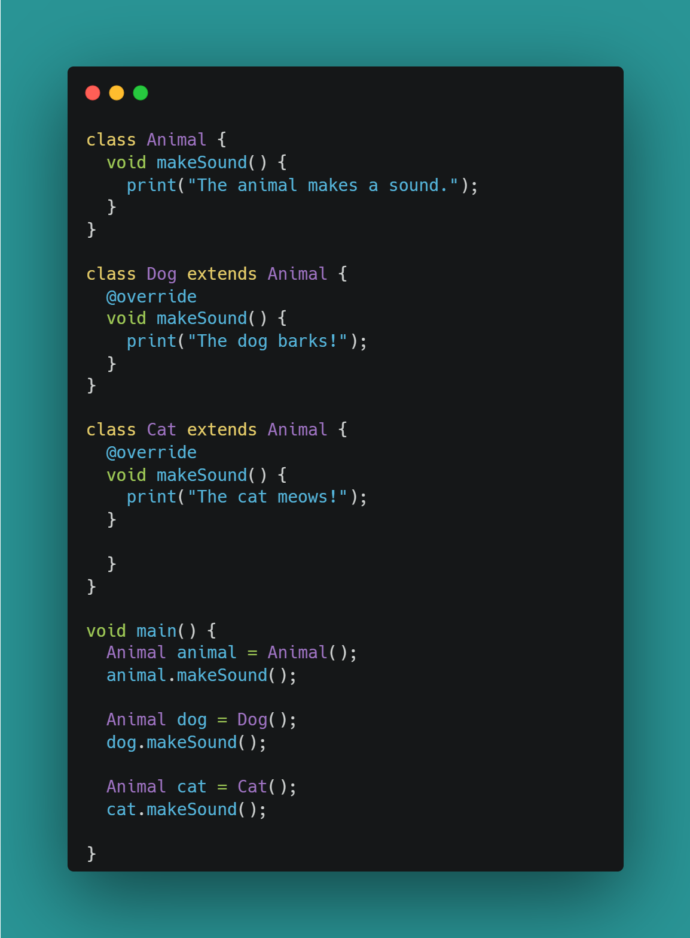
3
Inheritance
Polymorphism
4

Slide 40
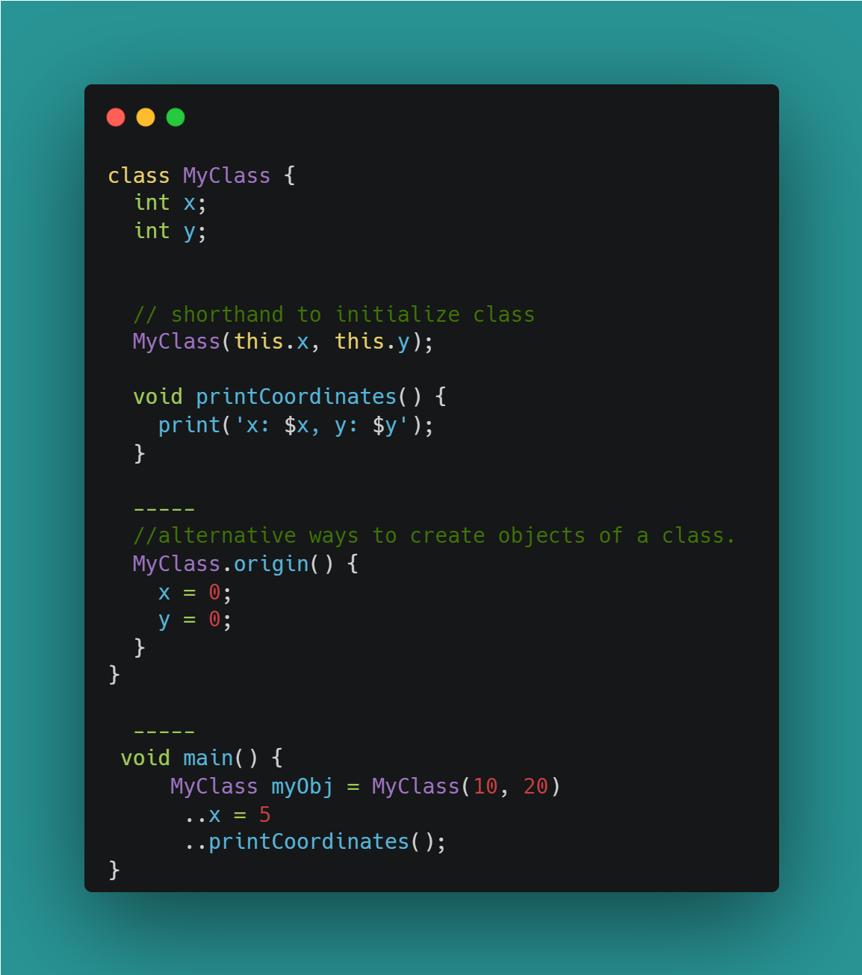
Some Shorthand notations in Dart

Slide 41
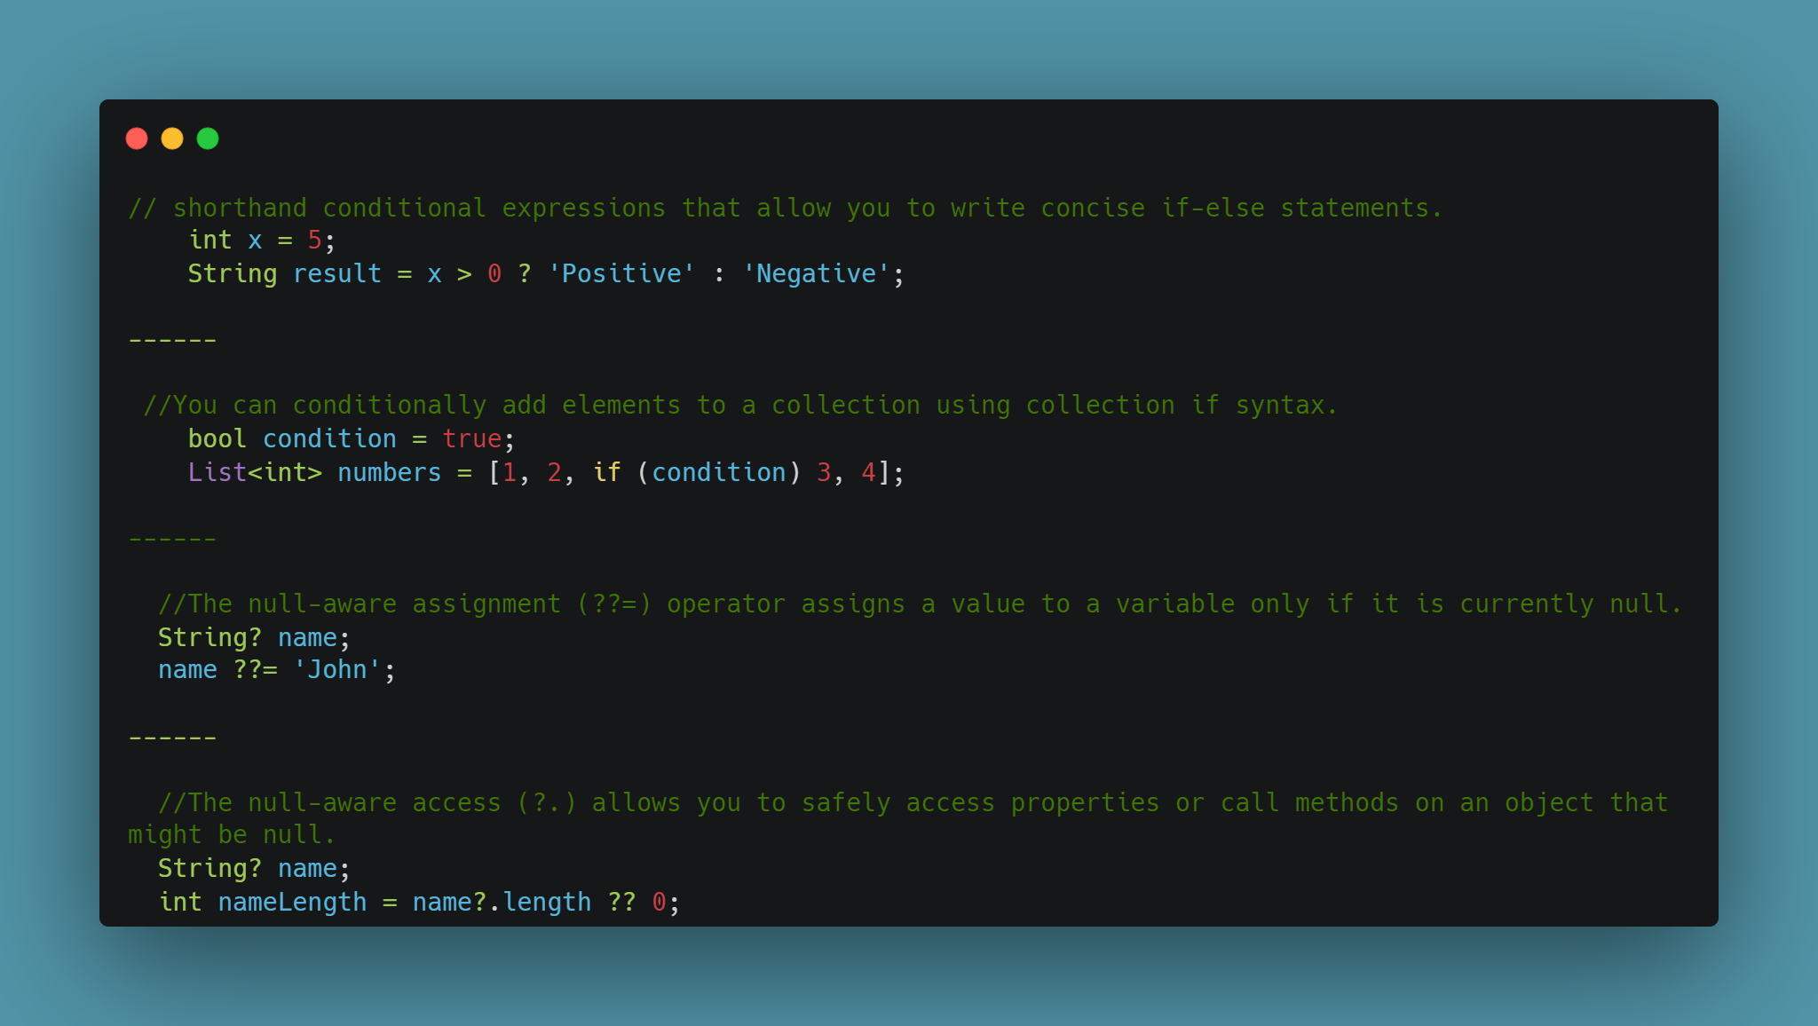

Slide 42
06
Asynchronous Programming

Slide 43
Future
In simple, future represent that data will be available after period of time (in future)

Slide 44
Asynchronous Programming
Don’t move from this part until execute this function
Notes:
Advanced Meaning: asynchronous operations are tasks that don't block the execution of the main thread, allowing the app to remain responsive.
Common examples of asynchronous operations include fetching data from a server, reading and writing files, and performing complex computations.

Slide 45
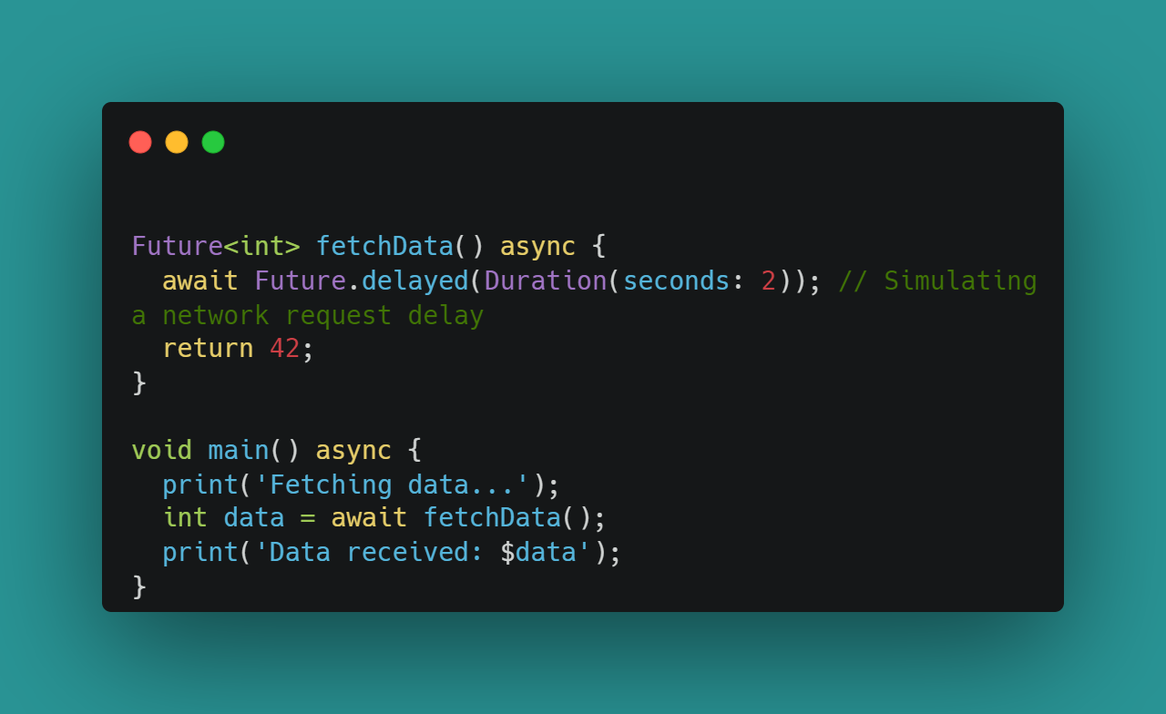
Asynchronous Programming

Slide 46
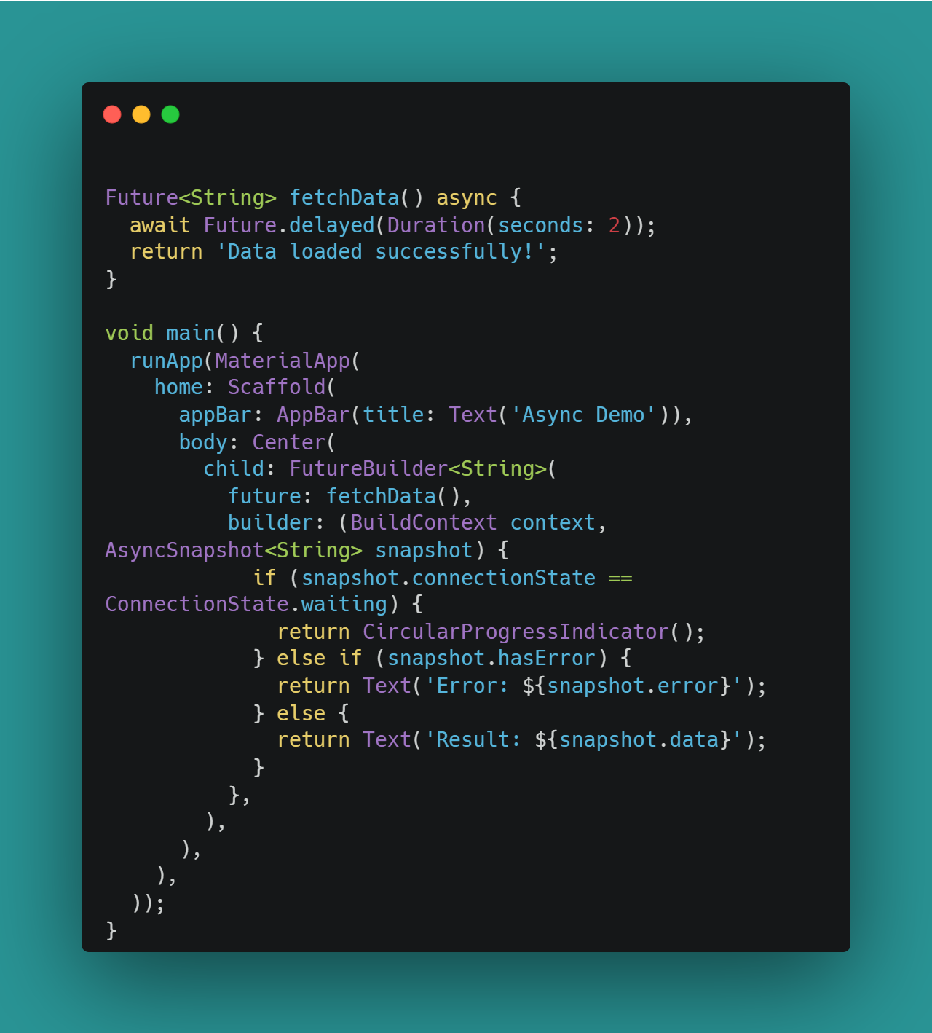

Slide 47
Exercises

Slide 48
void printVar(String name, int age) { name = "name"; age = 1000; print("$name $age"); } void main() { String name = "amira"; int age = 100; print("$name $age"); printVar(name, age); print("$name $age"); } what’s the output?
Notes:
amira 100
name 1000 amira 100

Slide 49
class A {
int a;
A(this.a);
}
void changeValue(A x, A y) {
x = y;
x.a++;
print(x.a);
print(y.a);
}
void main() {
A x = A(1);
A y = A(2);
changeValue(x, y);
print(x.a);
print(y.a); }
Notes:
3 3 1
3

Slide 50
class A {
int a;
A(this.a);
}
void increment(A x) {
x.a++;
print(x.a);
}
void main() {
A x = A(1);
A y = A(2);
increment(x);
print(x.a); }
Notes:
2 2

Slide 51
Task 3 Mohsens
Create system to calculate the total price of order
- Order consisting of 'margherita' and 'pepperoni' pizzas.
- different types of pizzas and their respective prices. The types include 'margherita’ , 'pepperoni' and 'vegetarian' each with its associated cost
(100 , 160 , 210 ).

Slide 52
Bonus 5 Mohsens
Given an integer n, return a string array answer
answer[i] == "multiple of 15" if i is divisible by 3 and 5. answer[i] == "multiples of 3" if i is divisible by 3. answer[i] == " multiples of 5" if i is divisible by 5. answer[i] == i (as a string) if none of the above conditions are true. Ex: Input: n = 3 Output: ["1","2","multiples of 3 "]

Slide 53
Thanks !
amira20nasser@gmail.com
LinkedIn
Amira Nasser | Facebook
If you have any problem , send to me 😊

